Slide 1
The Power of Shared Intelligence: Engineering a Federated Future for Women in AI
Theme is Give to Gain: Optimizing Nigeria’s AI Ecosystem through Collective Action
Dr. Sakinat Oluwabukonla Folorunso
Associate Professor of AI Systems & FAIR Data (OOU)
Ambassador, Women in AI (WAI) Nigeria
8/3/2026
Notes:
"Good afternoon, everyone. I am here today not just as an academic, but as an engineer of systems. As we celebrate International Women's Day, we often hear the phrase 'Give to Gain.' Today, I want to show you how this isn't just a social sentiment—it is a technical necessity for our future. Let’s talk about engineering a Federated Future."

Slide 2

Why Shared Intelligence Matters
AI innovation thrives on collaboration
Complex societal problems require collective expertise
Diverse perspectives improve AI fairness and impact
Women benefit strongly from collaborative networks
Notes:
Discuss how AI systems today rely on data, models, and knowledge from many contributors.
Emphasize that collaborative ecosystems allow women researchers to grow faster through shared opportunities and visibility.

Slide 3
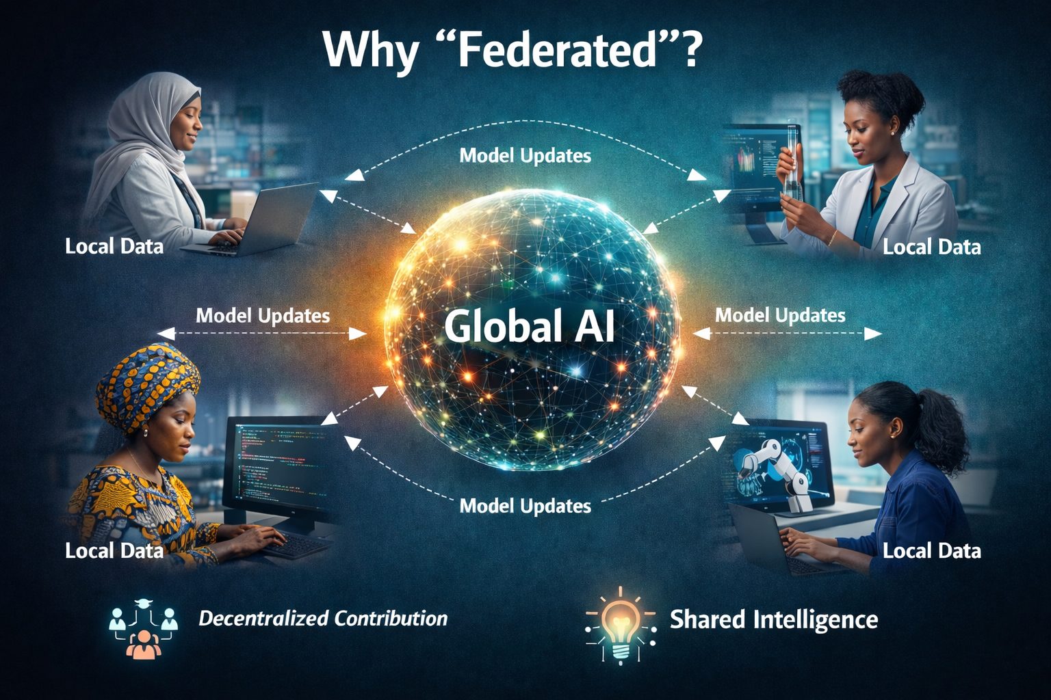
Why Federated?
Federated Learning allows models to learn from decentralized data
Data remains local while model knowledge is shared
Local identity and context remain preserved
Shift from centralized gatekeeping to decentralized empowerment
We don't need to lose our unique cultural identity or local context to be part of the global AI story.
Notes:
"In my research at ARISG, we study Federated Learning. Traditionally, to train AI, you move all data to one central server. But that’s a 'winner-take-all' model. Federated Learning is different—it leaves the data where it belongs, in the hands of the local user, and only shares the 'intelligence' gained.
This is my vision for women in Nigeria. We don't need to conform to Western standards to gain. We keep our local context, our unique perspectives, and our cultural nuances. We give our 'updates' to the global conversation to gain a world that finally recognizes us."

Slide 4
Federated Intelligence: A New Paradigm
Federated learning enables collaborative AI without sharing raw data
Models are trained across distributed nodes
Privacy and data ownership are preserved
Institutions contribute knowledge rather than raw data
Notes:
Explain federated learning in simple terms.
Instead of sending data to a central location, models travel to data.
Each node learns locally and contributes model updates.

Slide 5
Give to Gain: The Core Philosophy
Sharing knowledge strengthens ecosystems
Mentorship multiplies talent
Collaboration accelerates innovation
Inclusive AI benefits society
Notes:
Connect the technical concept of federated intelligence with the human concept of giving.
Explain that when researchers share knowledge and opportunities, everyone benefits.

Slide 6
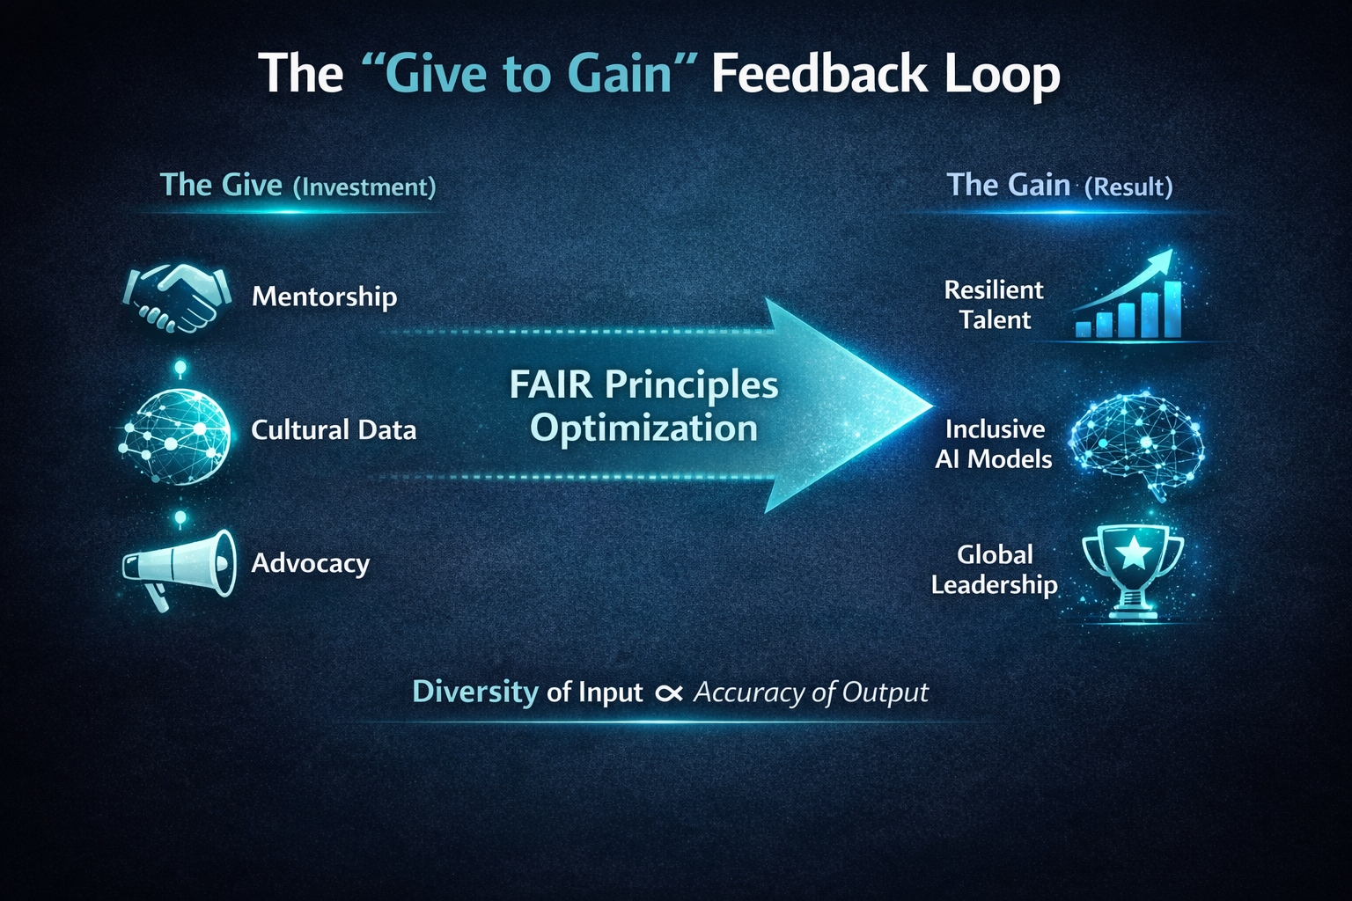
The 'Give to Gain' Feedback Loop
Notes:
"In AI, garbage in means garbage out. If we don’t 'Give' our time to mentorship through initiatives like TRAIL and IndabaX, we cannot 'Gain' a resilient workforce. If we don't 'Give' our local data, the 'Gain' is a biased system that doesn't understand our names or our needs.
We must treat our contributions as a high-value investment. When you mentor a young woman in NLP, you aren't just helping her; you are optimizing the entire network's output.“
The Give (Investment):
Mentorship (TRAIL & IndabaX)
Data Dignity (Contributing local Nigerian nuances)
FAIR Data Principles implementation
The Gain (Return):
Resilient Talent Pipelines
Bias-free, Culturally-aware Models
Global Leadership in the "Creative AI" space

Slide 7
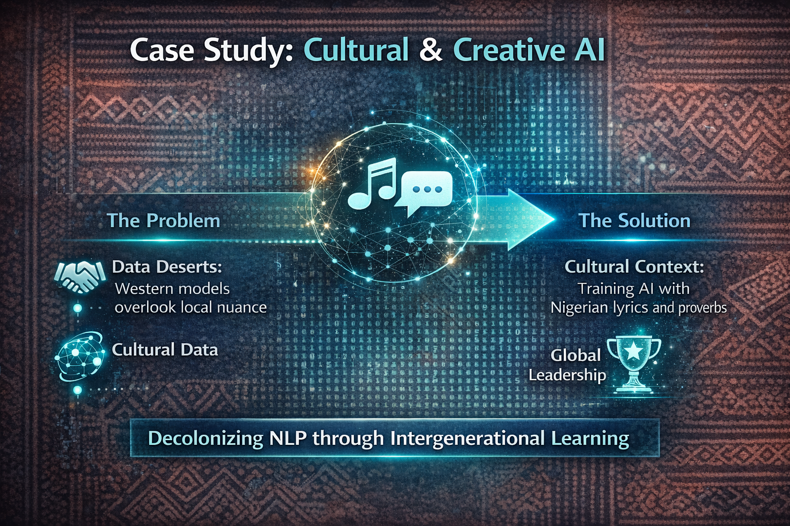
Case Study: Cultural & Creative AI
Giving Context to Gain Representation
Example: Research on Nigerian Lyrics and NLP.
Problem: Western-centric models oftenfail to capture African linguistic nuances.
Action: When we give our cultural data, we gain systems that actually understand us.
Quote: "If we are not in the training data, we do not exist in the future."
Notes:
"Let’s look at my work on Nigerian lyrics. Global models often struggle with the depth of our linguistic creativity. By 'Giving' our context—our proverbs, our slang, our rhythm—we 'Gain' AI that can truly create and innovate alongside us. This is how we move from being consumers of AI to being the co-creators of its future."

Slide 8
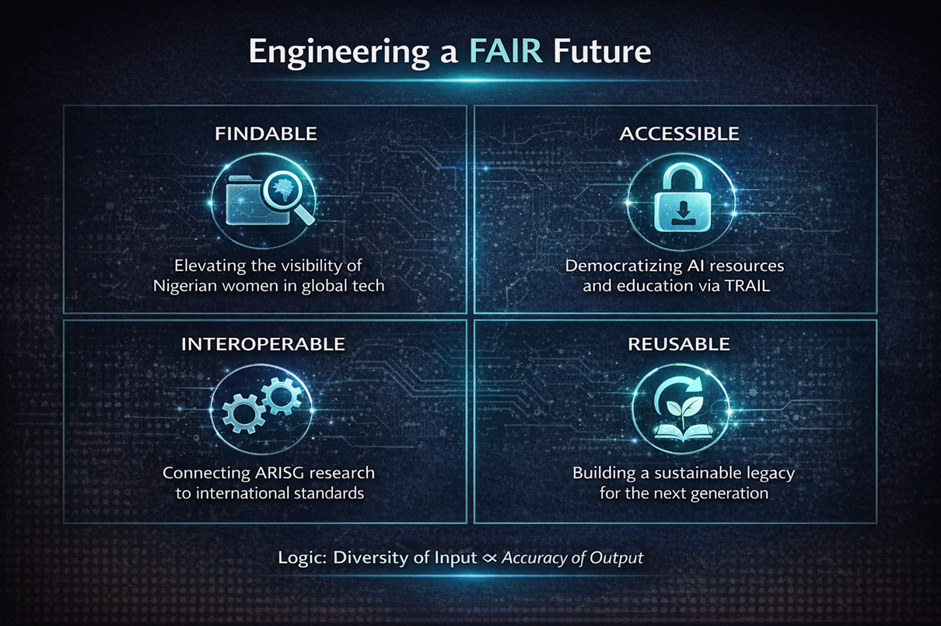
Engineering a FAIR Future
Findable: Increase visibility of Nigerian women in AI
Accessible: Expand access to AI education and tools
Interoperable: Align local research with global standards
Reusable: Ensure knowledge benefits future researchers
Notes:
"To make this gain sustainable, we must follow the FAIR principles. Our work at OOU focuses on making Nigerian data Findable and Accessible, but also Interoperable and Reusable. We aren't just building for today; we are building an infrastructure that allows the next generation of women to pick up exactly where we left off.“Findable: Making Nigerian women in tech visible globally.
Accessible: Breaking barriers to AI education and resources.
Interoperable: Connecting local research at ARIG with international standards.
Reusable: Ensuring our gains today empower the students of tomorrow.

Slide 9

Shared Intelligence in Practice
Open datasets and FAIR data practices
Collaborative AI research hubs
Community-driven innovation
Distributed AI labs across universities
Notes:
Mention examples such as open science collaborations, shared datasets, and distributed computing environments.
Emphasize the importance of FAIR data for inclusive research.

Slide 10
Call to Action: Your Node in the Network
Join the Network: Engage with Women in AI Nigeria and IndabaX
Share your "Update": Mentor at least one emerging researcher
Publish/Share datasets or open research resources
Advocate for ethical and inclusive AI policies
Advocate: Push for data policies that protect and empower.
Closing Quote: "Our shared intelligence is our greatest asset. Let’s engineer the future together."
Notes:
"Every one of you in this room is a node in this network. Your 'Give' is the input; the future of Nigerian AI is the 'Gain.' I challenge you today: what update will you share? Whether it’s through Women in AI Nigeria or IndabaX, your participation is what makes the global model work. Let’s engineer a future that belongs to all of us."

Slide 11
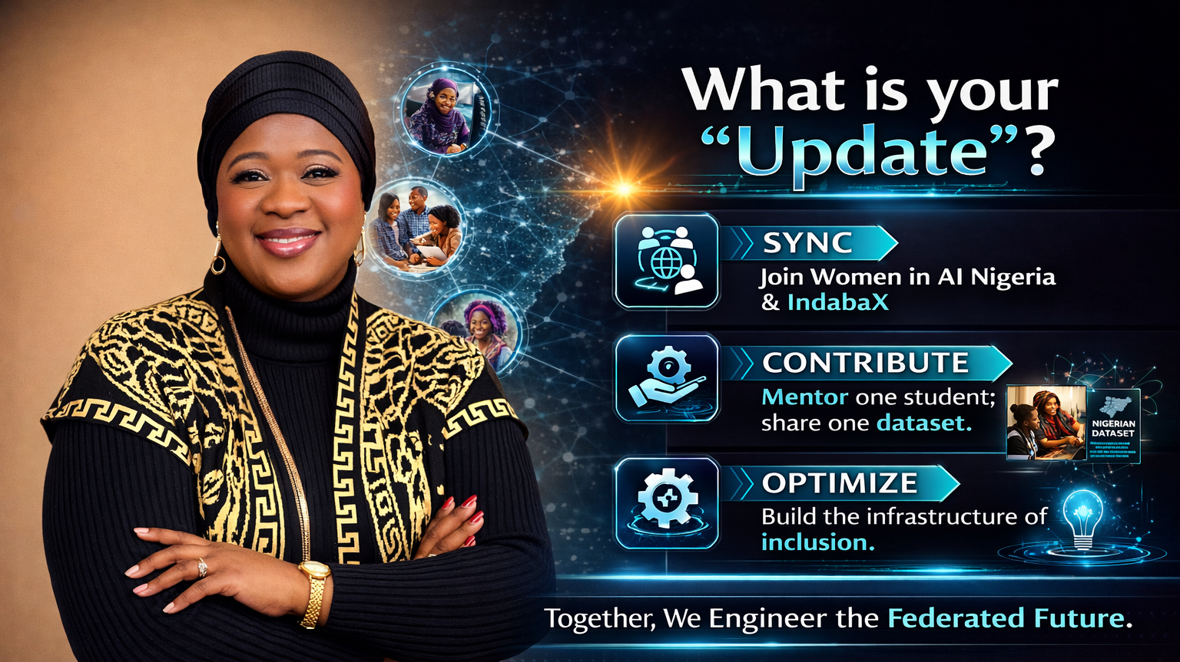
Notes:
"Every one of you in this room is a node in this network. Your 'Give' is the input; the future of Nigerian AI is the 'Gain.' I challenge you today: what update will you share? Whether it’s through Women in AI Nigeria or IndabaX, your participation is what makes the global model work. Let’s engineer a future that belongs to all of us."

Slide 12
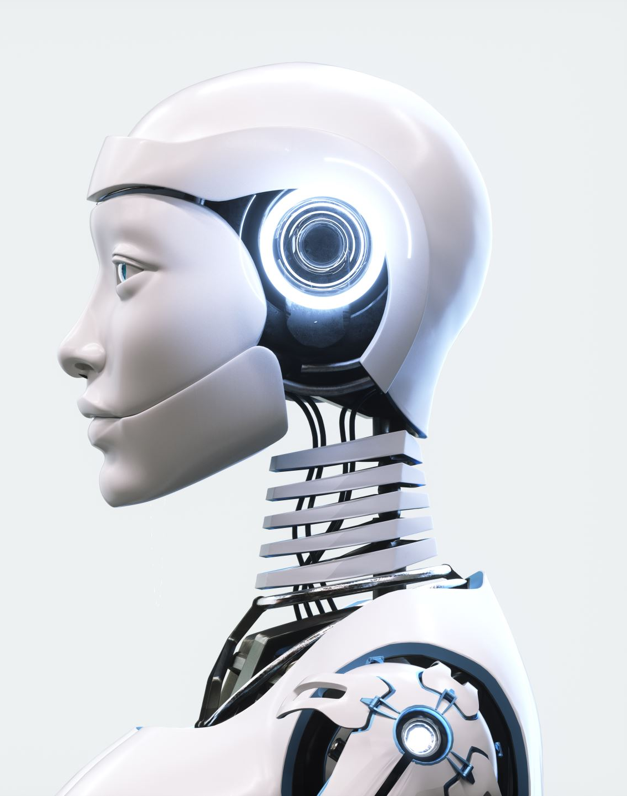
Closing Thought
The future of AI is not isolated intelligence
It is shared intelligence
It is collaborative innovation
And it is women shaping the future of technology
Notes:
End with an inspirational message emphasizing collective progress.
Highlight the importance of women’s leadership in shaping the next generation of AI innovation.

Slide 13
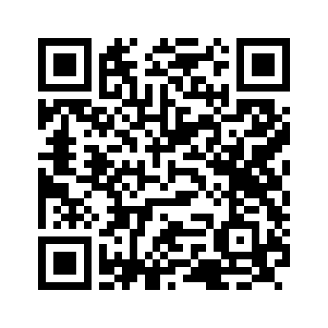
Let’s Collaborate!
Dr. Sakinat Folorunso
Associate Professor of AI Systems and FAIR Data
Department of Computer Sciences
Olabisi Onabanjo University, Nigeria
sakinat.folorunso@oouagoiwoye.edu.ng

